Slide 1
Measurement of Elasticity of Demand

Slide 2
MEASUREMENT OF PRICE ELASTICITY:
In order to measure the price elasticity, there are three methods available in economic literature. They are:
Total Outlay Method
Point Method
Arc Method.

Slide 3
Total outlay method
Dr. Marshall has evolved the total expenditure method to measure the price elasticity of demand.
This method is also known as total expenditure method. Under this method the price elasticity is measured in terms of pattern of expenditure on any commodity. That is as price falls, the law of demand states that demand rises.
But here the question is, what happens to the expenditure on that commodity.
Will expenditure increase or decrease or remain constant?. Based on this i.e. expenditure pattern, the price elasticity of demand is explained in terms of
Elastic demand
Unitary elastic demand
Inelastic demand
Total Outlay = Price X Quantity Demanded

Slide 4
Elastic demand: When the total amount spent on goods increases with a fall in price and decreases with a rise in price. Then, elasticity is said to be greater than unity or elastic demand.
Unitary elastic demand: When the total amount spent on goods remain the same before and after the price change, then it is called Unity Elasticity. That is, the rise in price is exactly balanced by reduction in purchases and vice-versa.
Inelastic demand: When the total amount spent on goods decreases with a fall in price and increases with a rise in price. Then, it is called elasticity less than unity or inelastic demand.
We can understand elastic, unitary elastic and inelastic demand with the help of following example:

Slide 5
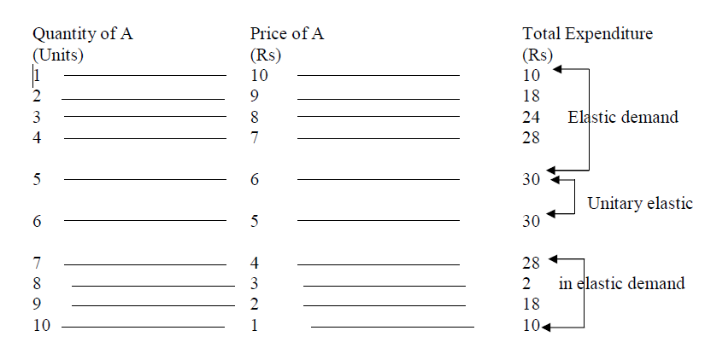

Slide 6
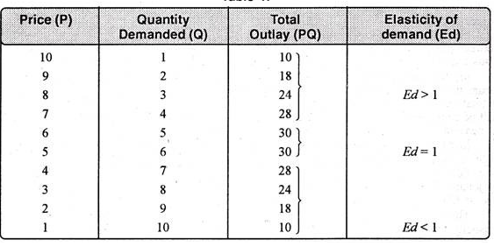

Slide 7
According to the above example, as price falls from Rs.10 to Rs 6,the quantity of A commodity increased from 1 unit to 5 units and the expenditure on A commodity increased from Rs 10 to Rs 30. So this is the case of elastic demand.
As price falls from Rs 6 to Rs 5, the quantity of A increased from 5 units to 6 units. But the expenditure on the commodity remains constant. So this is the case of unitary elasticity.
Finally, as the price falls from Rs 5 to Rs 1 the quantity of A increased but the expenditure on this commodity decreased from Rs 30 to Rs 10. So this is inelastic demand.
By plotting the above data in a diagram we can derive the total expenditure total outlay curve. The shape of the total expenditure curve is shown below.

Slide 8
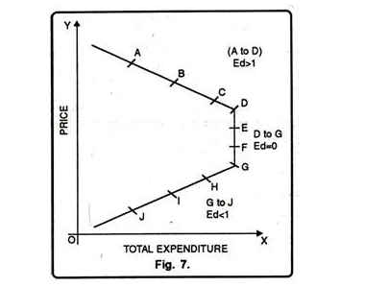

Slide 9
In the above diagram, the total outlay curve A to D is shown in three segments i.e., A to B, B to C and C to D.
The segment of A to B is showing the case of Elastic Demand, where the total outlay is increasing with a fall in the price.
The second segment B to C is showing the case of Unity Elasticity ,where the total outlay is the same before and after the price change.

Slide 10
The third segment C to D is showing the case of inelastic demand, where the total outlay is falling with a fall in the price.
Thus, in the total outlay method, the price elasticity of demand is measured by comparing the changes in the total outlay spent by the buyer before and after the price change.

Slide 11
Point elasticity Method
This method helps us to measure the elasticity of demand at any point on the demand curve.
This method has also been given by Alfred Marshall and is known as ‘Geometric method’.
Under this method, the principle for estimating price elasticity at any point on the demand curve is shown below.

Slide 12
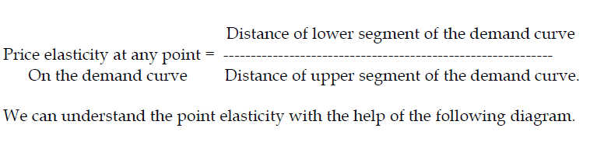

Slide 13
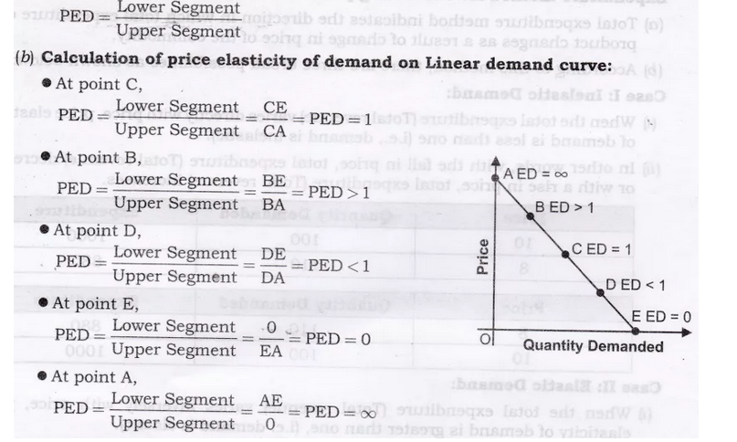

Slide 14
In the above diagram we have drawn a straight line demand curve AE and identified different points on this curve such as A,B,C,D and E.

Slide 15
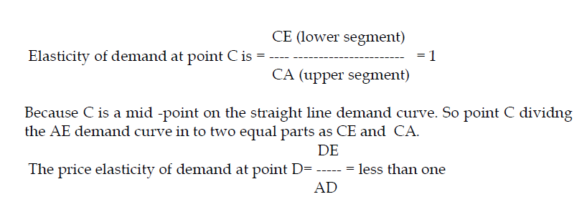

Slide 16
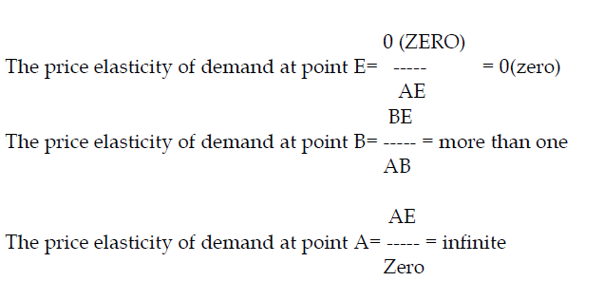

Slide 17
Arc Method
This method is used to find out price elasticity on a segment of the demand curve rather than at a particular point.
“When elasticity is computed between two separate points on a demand curve, the concept is called Arc elasticity” Leftwitch

Slide 18
The main drawback of the point method is that it can be used only when we have complete data on the changes in the price of the good and quantity demanded.
But, in real life, it is not easy to get information about the slightest changes in price and quantity.
This means that there will be GAPS in the demand schedules. In such cases, it is not possible to apply the point method to get the desired results. Economists have therefore, devised a new method called Arc method wherever big gaps are there in the demand schedule.

Slide 19
In the arc metod , the mid-points between the old and new data in the cade of price and quantity are used..this method studies a portion or segment (Arc)of the demand curve between the two points.
Hence, Arc method is the elasticity at the mid-point of an Arc of a demand curve.Hence, the formula for measuring elasticity of demand under Arc method is,

Slide 20
